Slide 1
802 Project Summary
Maksuda Toma, Jo Charbonneau, and Ryan Lalicker

Slide 2
Background & Context
The consumption of beef jerky has been linked to several illnesses and hospitalizations, most of which involving E. Coli or Salmonella. This has lead to several recalls of beef jerky which have been linked to these bacteria.
A study evaluated the effect of two different inoculation methods on Salmonella populations in beef jerky of different thicknesses. The variables involved were:
Salmonella counts
Inoculation methods (dry and wet)
Thickness (¼ inch and ⅛ inch)
Time (weeks 1-5)

Slide 3
Design
2x2 factorial design with repeated measures over time:
Inoculation method (dry vs. wet)
Thickness (¼ & ⅛ inch)
5 equally spaced time points (Weeks 1-5)
5 batches

Slide 4
Model
𝑌_{𝑖𝑗𝑘𝑙} = 𝜇 + 𝛼_{𝑖} + 𝛽_{𝑗} + 𝜏_{𝑘} + (𝛼𝛽)_{𝑖𝑗} + (𝛼𝜏)_{𝑖𝑘} + (𝛽𝜏)_{𝑗𝑘} + (𝛼𝛽𝜏)_{𝑖𝑗𝑘} + 𝑢_{𝑙} + 𝑒_{𝑖𝑗𝑘l}
𝑌_{𝑖𝑗𝑘𝑙}: Salmonella Level
𝜇: overall mean
𝛼_{𝑖} :the effect of the 𝑖th inoculation method
𝛽_{𝑗}: the effect of the 𝑗th thickness level
𝜏_{𝑘}: r the effect of the 𝑘th week
(𝛼𝛽)_{𝑖j}: interaction effect of the 𝑖th inoculation method and the 𝑗th thickness level
(𝛼𝛽𝜏)_{𝑖𝑗𝑘}: three-way interaction between all fixed effects
𝑢_{𝑙}: random effect for batches
𝑒_{𝑖𝑗𝑘l} : residuals

Slide 5
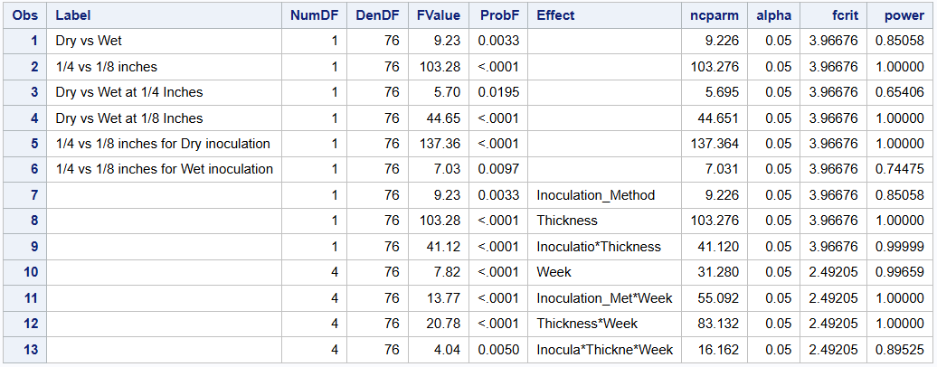
Power Analysis
Orthogonal contrasts between variables:
Difference between inoculation methods (dry and wet)
Difference between thickness (¼ and ⅛ inch)
Generated dataset between five batches, identical response variables across batches. The dataset was then evaluated to determine the power.
Many terms show >80% power, and fixed effects were strong enough to then proceed

Slide 6
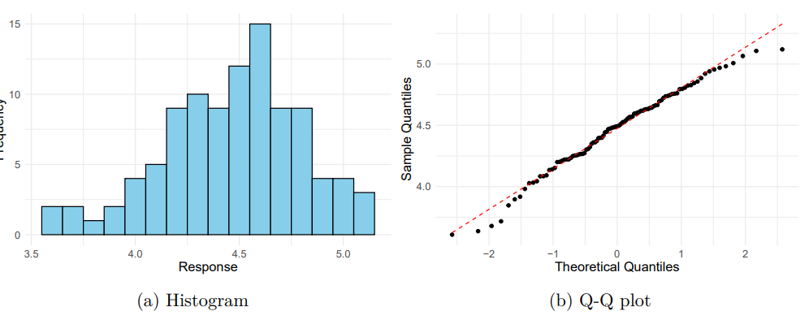
Distribution of Response
Plots to show distribution of response variable:
Histogram indicates a slight skew, but not enough to say the distribution is not normal
Q-Q plot is indicative of a normal distribution

Slide 7
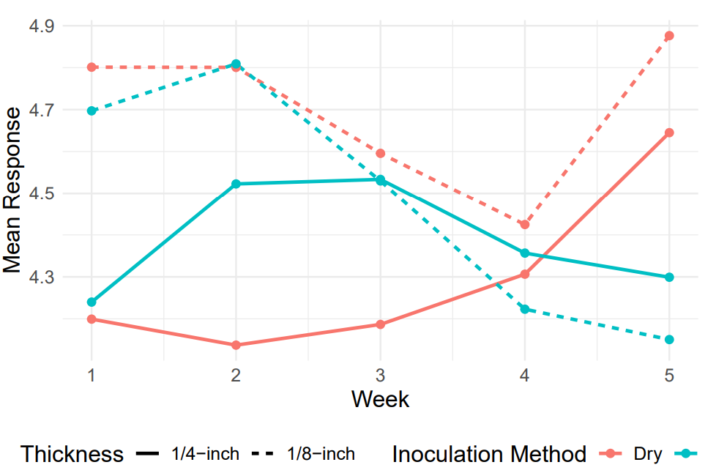
Exploration
Wet inoculation method (blue lines) - mean response tends to decrease over time
Dry Inoculation (red lines) - mean response tends to increase over time
⅛ inch thickness - responses were similar, diverging at the end of the experiment
¼ inch thickness - Showed more variation

Slide 8
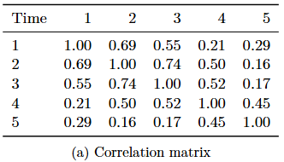
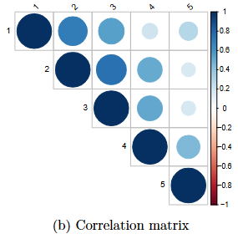
Correlation Over Time
Because this is a repeated measures experiment, we need to account for this variance by selecting a covariance structure.
Plan to use AR(1) structure
Suited for equally spaced, ordered data over time
Strong correlations observed between adjacent weeks
Week 1 vs. Week 2 (r = 0.69)
Week 2 vs. Week 3 (r = 0.74)
Correlations weaken as time gap increases

Slide 9
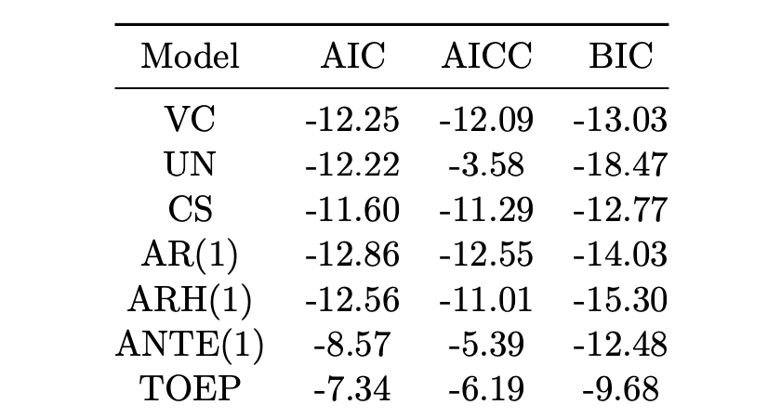
Model Comparison
While confident in AR(1), we also tested other covariance structures for comparison.
From the model comparison:
AR(1) structure is the best fit with the lowest AIC and AICC, and a respectable BIC score
In verifying model assumptions, we must check that residuals are normally distributed and homogeneous

Slide 10
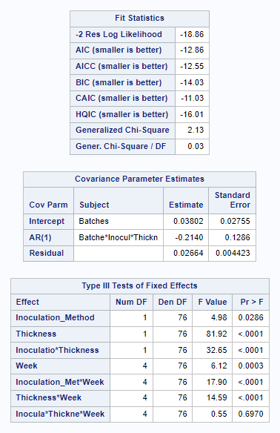
Model Results
Model Fit and Variance Components:
The model successfully converged, with variance estimates for random intercepts (batches: 0.03802) and residuals (0.02064)
The AR(1) autocorrelation (-0.2140) indicates weak negative correlation between adjacent time points.
Interaction Effects:
Highly significant interactions for all two-way interactions (𝑝<0.0001) while the three-way interaction (𝑝=0.6970p=0.6970) is not significant.

Slide 11
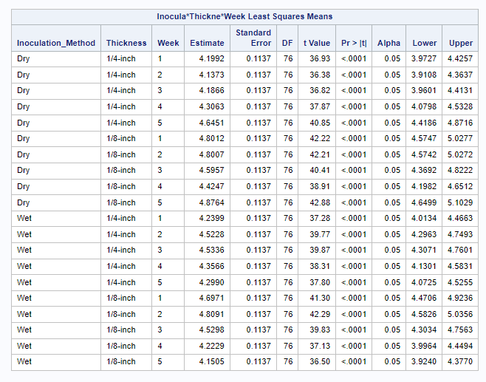
Model Results
LSMeans Overview:
The table shows the estimated response for combinations of Inoculation Method, Thickness, and Week, with all combinations being highly significant (𝑝<0.0001) and confidence intervals confirming reliability
Trends:
For 1/4-inch thickness, both Dry and Wet methods show increases over time, with Dry typically having higher responses. For 1/8-inch thickness, the differences between Dry and Wet are smaller but still notable.

Slide 12
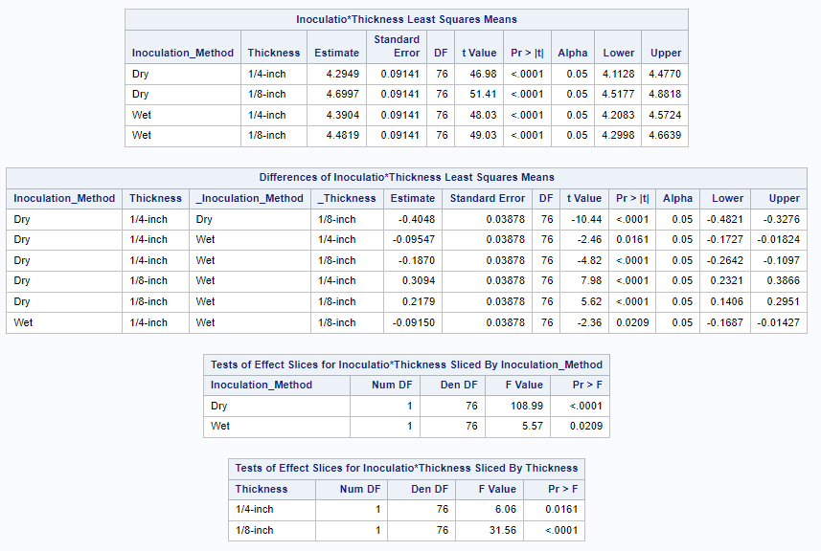
Model Results- Method*Thickness
Both inoculation method (Dry or Wet) and thickness (1/4-inch or 1/8-inch) significantly affect the outcome, with 1/8-inch consistently leading to higher responses than 1/4-inch (𝑝<0.0001).
Significant differences are observed between Dry and Wet methods, with Wet generally performing better at 1/4-inch thickness and more noticeable differences at 1/8-inch thickness.

Slide 13
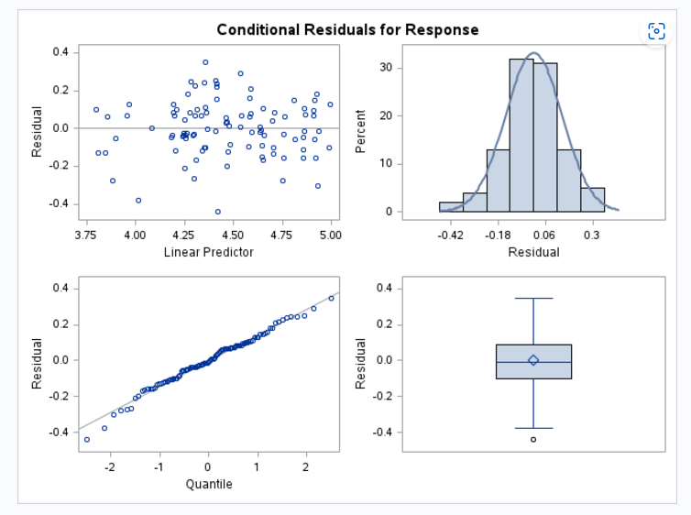
Model Result- Assumption Checking
The histogram and Q-Q plot indicate that residuals are approximately normal, supporting the normality assumption
The residual plot shows no clear pattern, suggesting that the assumption of constant variance (homoscedasticity) holds
The boxplot shows one potential outlier, but it does not significantly impact normality
Overall, residual diagnostics confirm that key assumptions of the model are satisfied.

Slide 14
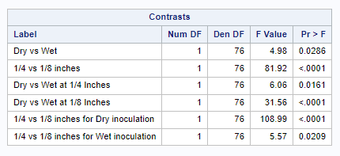
Model Result - Contrasts
Significant differences in inoculation method
Highly significant difference in thickness
All orthogonal contrasts are significant

Slide 15
Citations
Bobbit, Zach. 2021. “How to Interpret Negative AIC Values.” Statology. 2021.https://www.statology.org/negative-aic/.
Brown, Jessica, Taylor Bannon, Arie Havelaar, Chad Carr, Barbara B. Kowalcyk, and JasonM. Scheffler. 2024. “Inactivation of Salmonella Enterica, Escherichia Coli O157:H7, andCampylobacter Jejuni in a Restructured Beef Jerky Developed for Production in Ethiopia.”Meat and Muscle Biology8 (April): 1–12.https://doi.org/10.22175/mmb.16091.
Lipka, Alex, and Benjamin Tyner. 2004. “Repeated Measures Covariance Structure.” Sta-tistical Consulting Service - Purdue University. 2004.https://www.stat.purdue.edu/scs/help/method/Repeated%20measures%20analysis.pdf.
USDA. n.d. “Appendix e: Selecting an Appropriate Covariance Structure,” n.d., E.1–8.https://www.ars.usda.gov/ARSUserFiles/80000000/StatisticsGroupWebinars/Appendix%20E%20-%20Selecting%20a%20Covariance%20Structure.pdf.11

